Slide 1
Individual set | No. of annotated genes | Total no. of annotations | No. of co-annotated gene pairs
EcoCyc pathways | 782 | 2344 | 7,787
EcoCyc protein complexes | 1178 | 1582 | 1,305
Operons | 3514 | 5424 | 3,605
Regulons | 1467 | 3929 | 215,711
KEGG modules | 333 | 524 | 1,503
Combination
Pathways or complexes | 1660 | 3926 | 8855
Pathways and complexes | 543 |  | 237
Any (Union) | 3802 | 13803 | 223126
All (Intersection) | 79 |  | 116

Slide 2
Ranking Similarity | 1th | 100 th | 200 th | 300 th | 400 th | 500 th
|PCC| | 0.96 | 0.92 | 0.90 | 0.89 | 0.87 | 0.86
MI | 1.20 | 0.60 | 0.47 | 0.42 | 0.39 | 0.37
|Spearman| | 0.94 | 0.76 | 0.66 | 0.63 | 0.61 | 0.59

Slide 3
Ranking Similarity | 1th | 100 th | 200 th | 300 th | 400 th | 500 th
|PCC| | 0.96 | 0.92 | 0.90 | 0.89 | 0.87 | 0.86
MI ternary | 0.72 | 0.20 | 0.20 | 0.20 | 0.20 | 0.18
MI ternary cond collapsed | 0.87 | 0.43 | 0.43 | 0.43 | 0.42 | 0.39

Slide 4
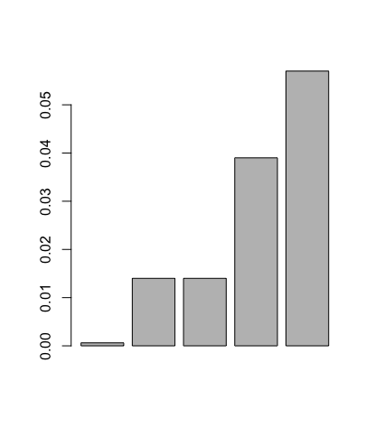
Mean

Slide 5
Notes:
*|PCC| for metabolic pathways
*AvgPCC_pwy&ptcomplex_obj_prep.R + AvgPCC_pwy&ptcomplex.R

Slide 6
Notes:
*|PCC| for protein complexes
*AvgPCC_pwy&ptcomplex_obj_prep.R + AvgPCC_pwy&ptcomplex.R

